Slide 1
2024-07-03_S20-S21-S22-S23
Sxx_Icell_txxxx_Cxxxx_J01
Gottfrid Olsson

Slide 2
Goals with this session
Investigate how the deposition of Li is affected by
10 cycles of plating/stripping (S20, S21)
Using LFP (10mm diameter) as cathode instead of Li-metal (5mm diameter)

Slide 3
I’ll use 10kV3.0nA
SED multiplier voltage: 1530
Contrast: 26
Brightness:
Coarse: 71
Fine: 50

Slide 4
S20_Icell_t1800_C0010_J01; plating/stripping with final deposition

Slide 5
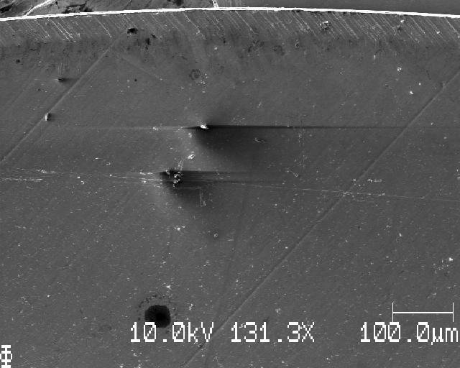
S20: top edge of sample

Slide 6
Changed to
SED multiplier voltage: 1560
Contrast: 28
Brightness:
Coarse: 71
Fine: 50

Slide 7
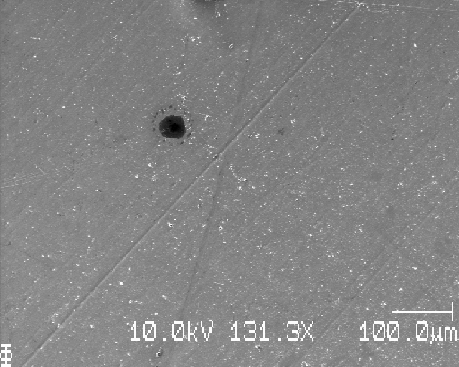
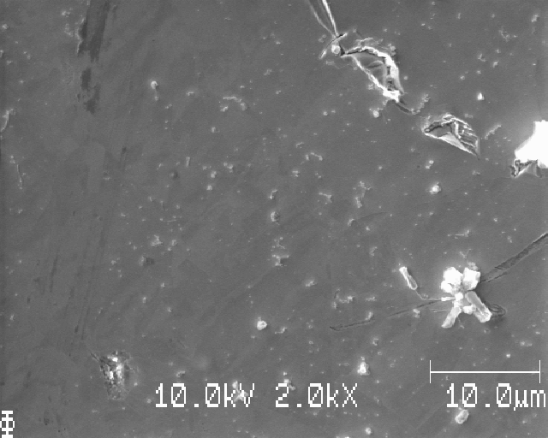
S20: moving down

Slide 8
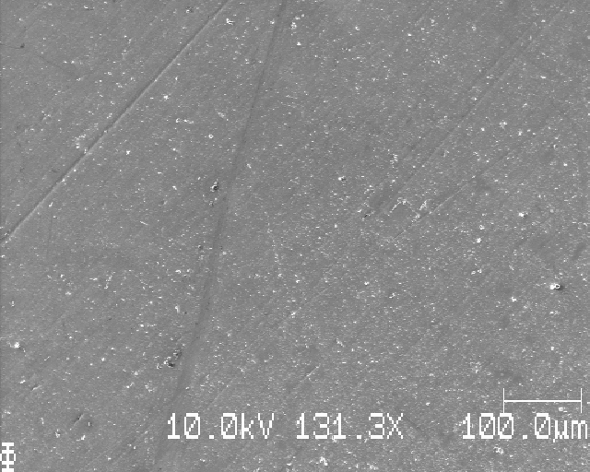
S20:

Slide 9
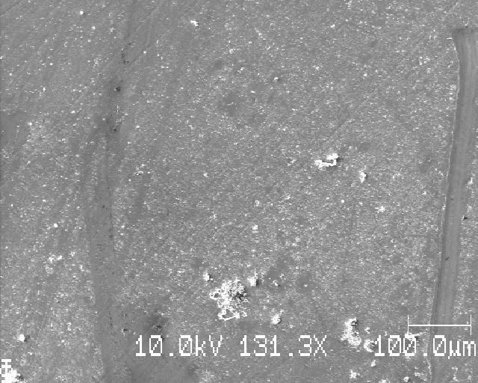
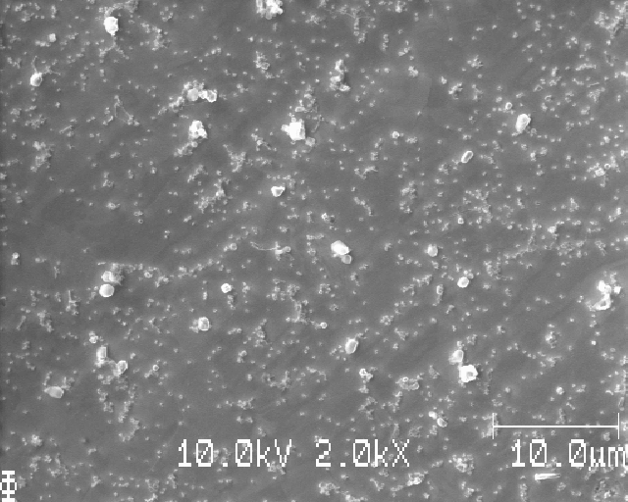
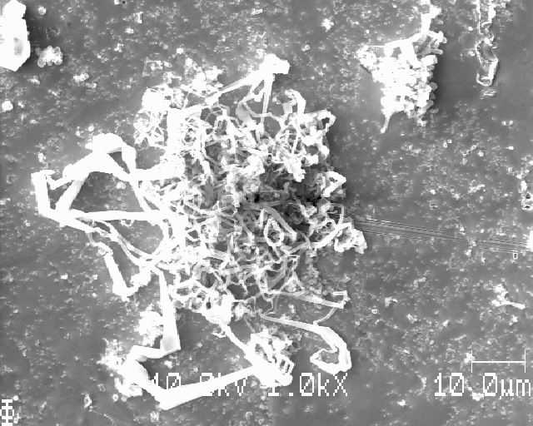
S20:

Slide 10
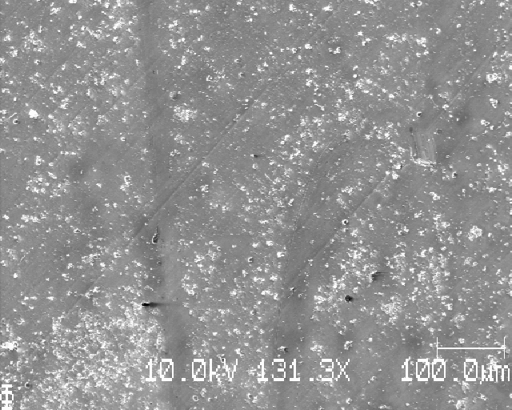
S20:

Slide 11
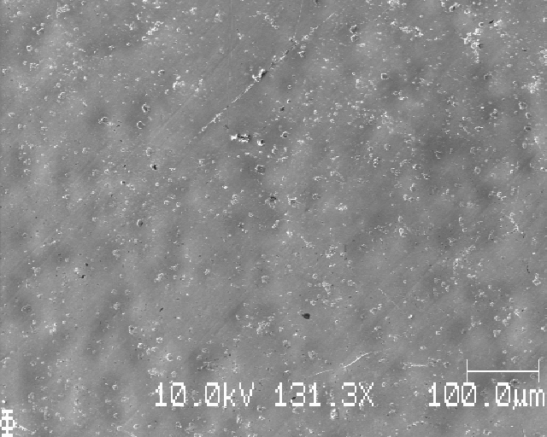
S20:

Slide 12
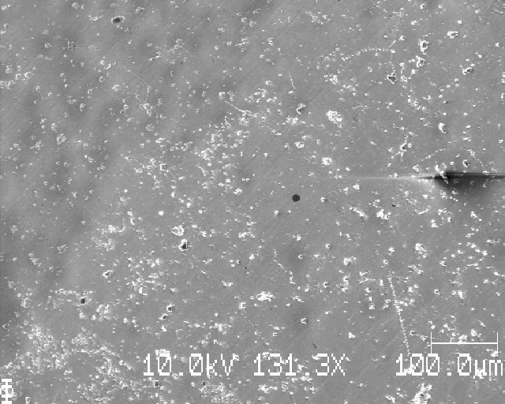
S20:

Slide 13
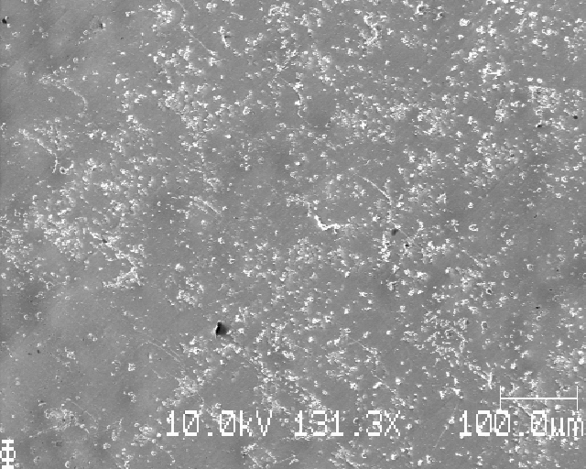
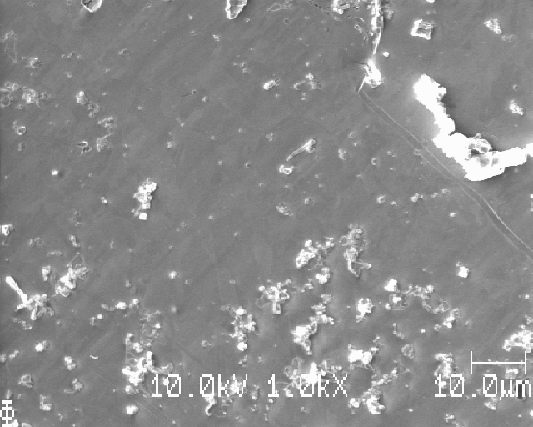
S20:

Slide 14
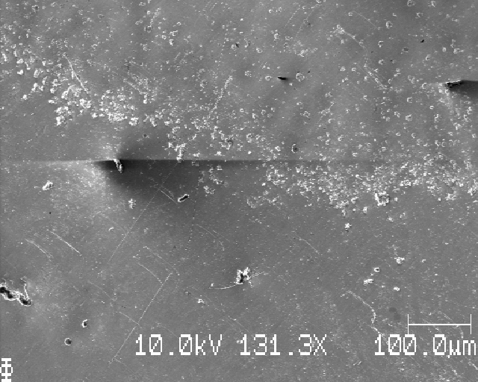
S20:

Slide 15
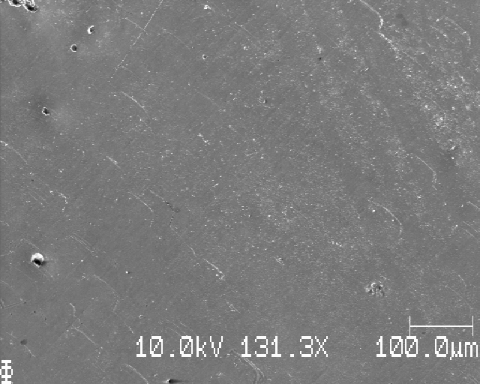
S20:

Slide 16
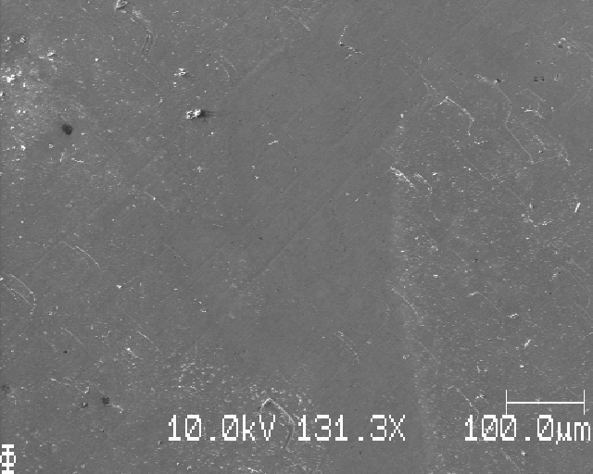
S20:

Slide 17
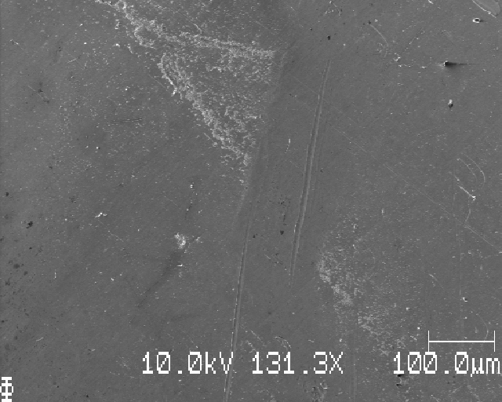
S20:

Slide 18
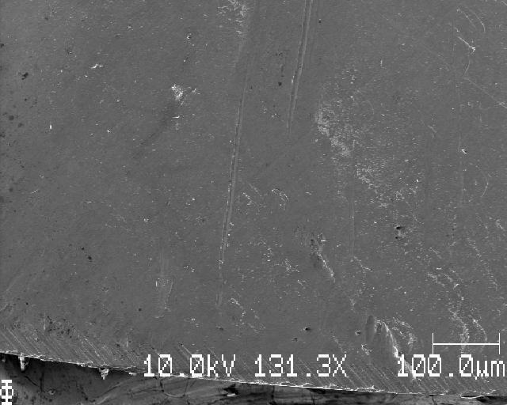
S20:

Slide 19
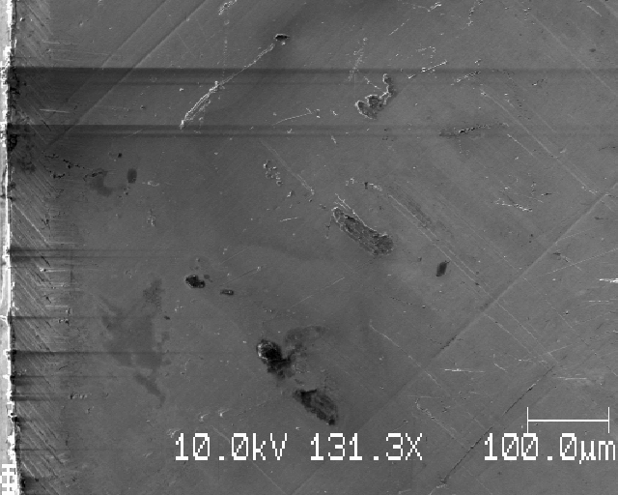
S20: left edge of sample

Slide 20
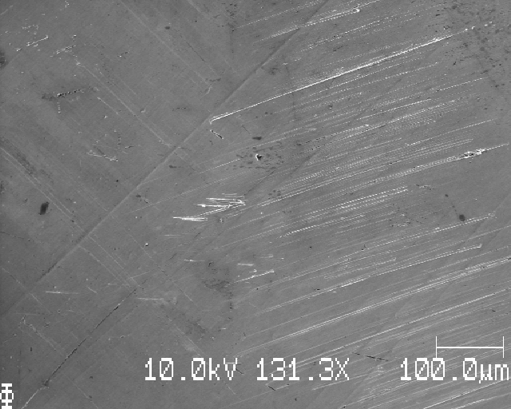
S20: moving right in steps of dx=0.75mm

Slide 21
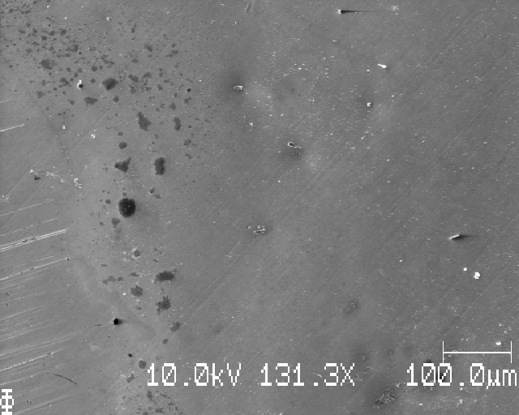
S20:

Slide 22
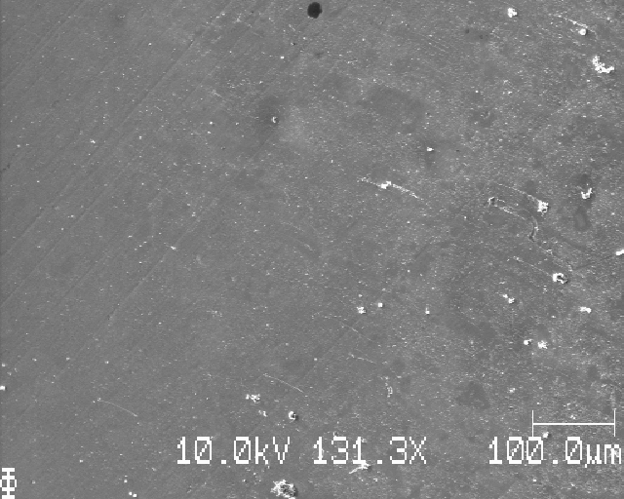
S20:

Slide 23
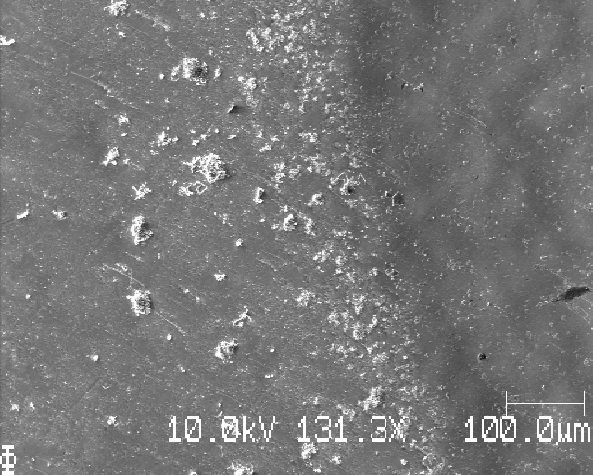
S20:

Slide 24
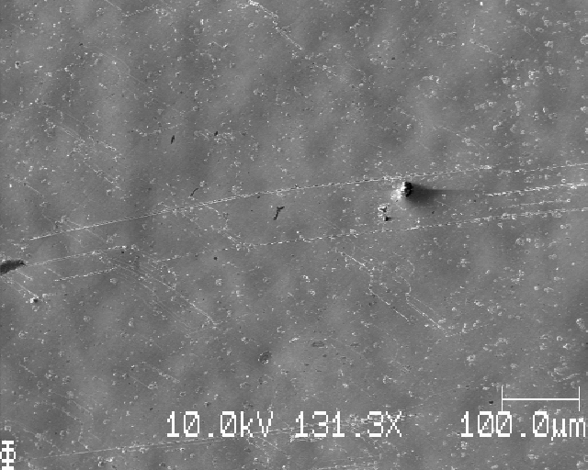
S20:

Slide 25
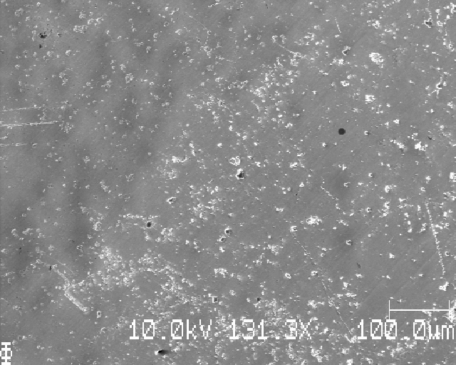
S20:

Slide 26
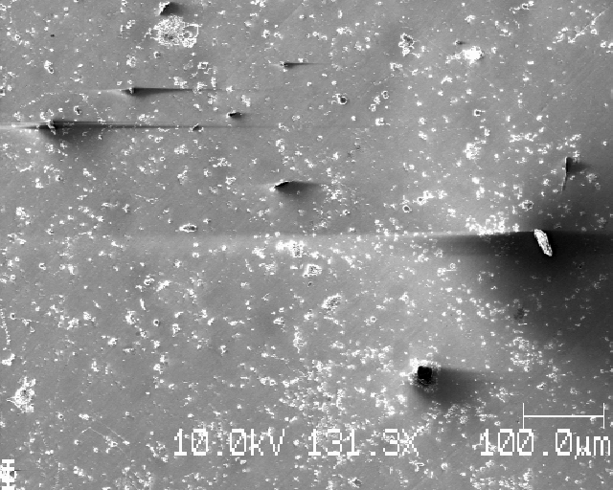
S20:

Slide 27
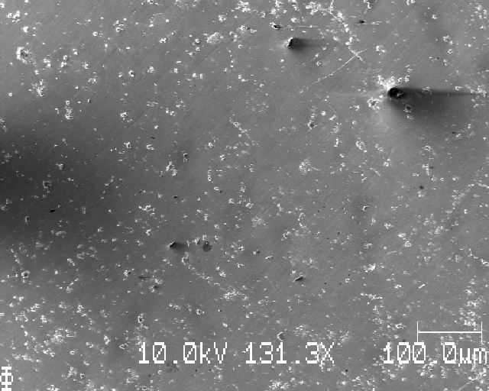
S20:

Slide 28
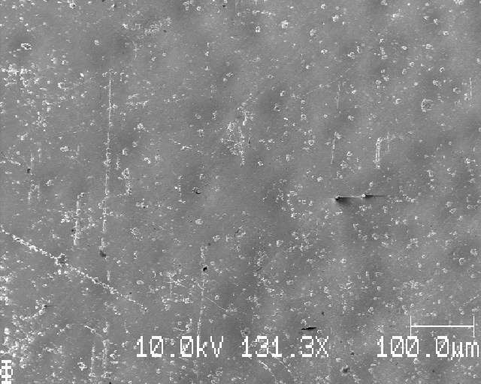
S20:

Slide 29
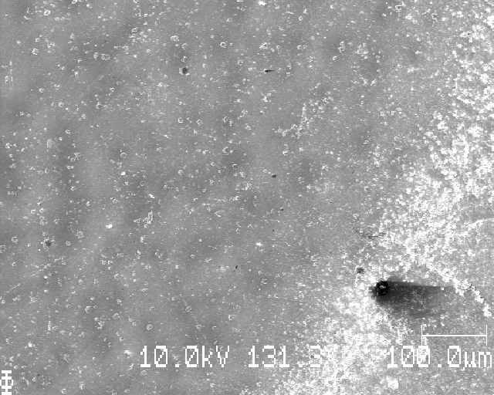
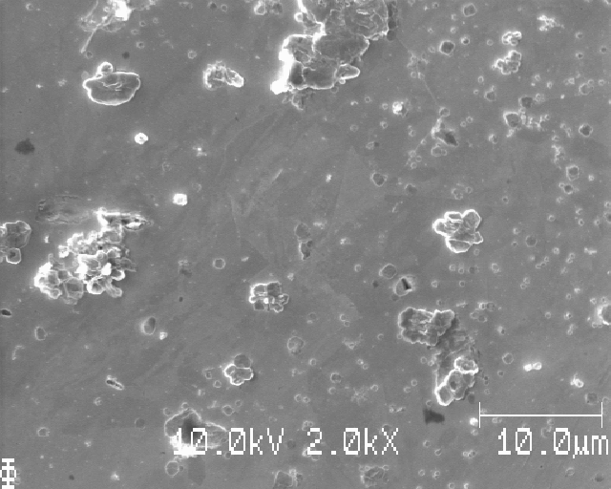
S20:

Slide 30
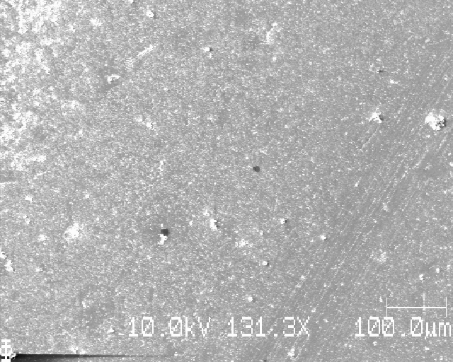
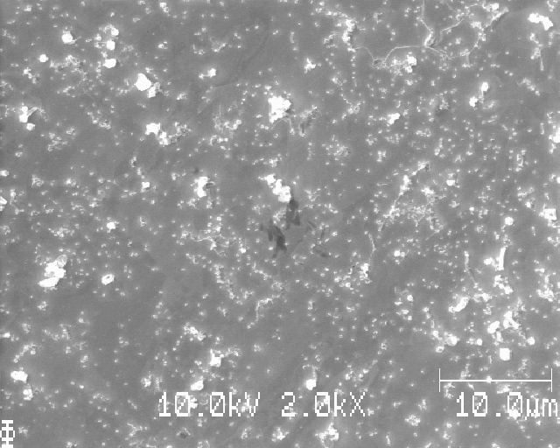
S20:

Slide 31
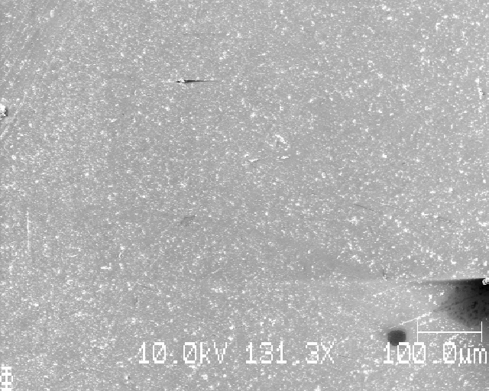
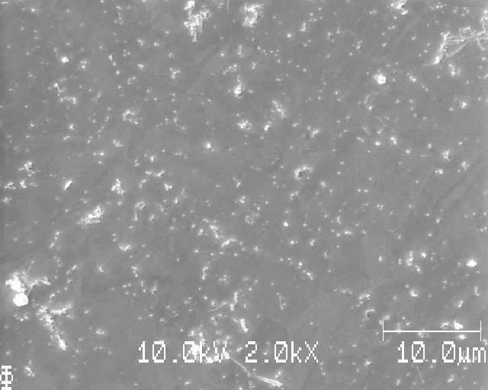
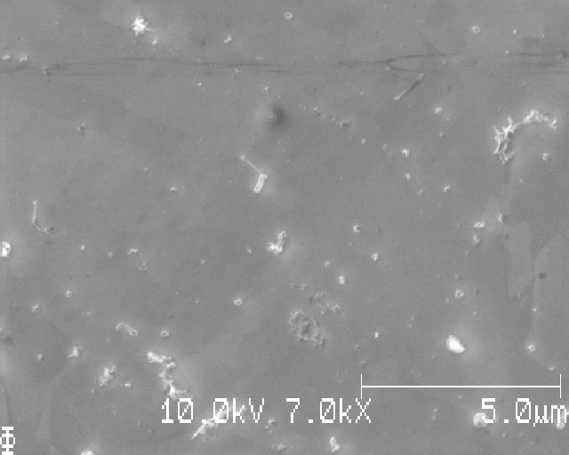
S20:

Slide 32
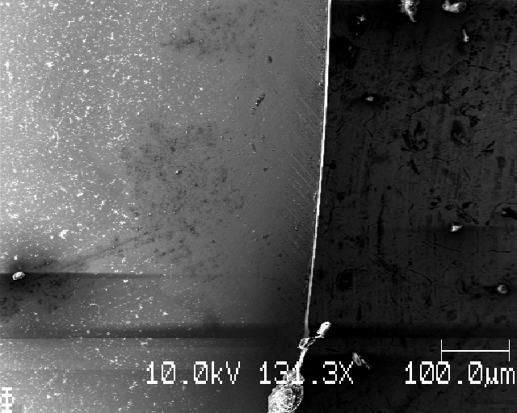
S20:

Slide 33
S20: learning points
See deposited Li
But, there is a large variation in sized and shapes
Some very small Li parts, some very large structures
No clear 5 mm Li disk of deposition, looks like Li over a much larger area on the Cu
This measurement would Not be suitable for image analysis

Slide 34
(next sample)

Slide 35
S21_Icell_t1800_C0000_J01; plating and stripping, last cycle was stripping

Slide 36
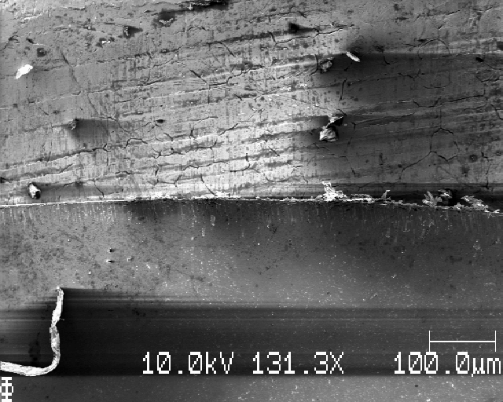
S21: top edge, moving down, dy=0.75mm

Slide 37
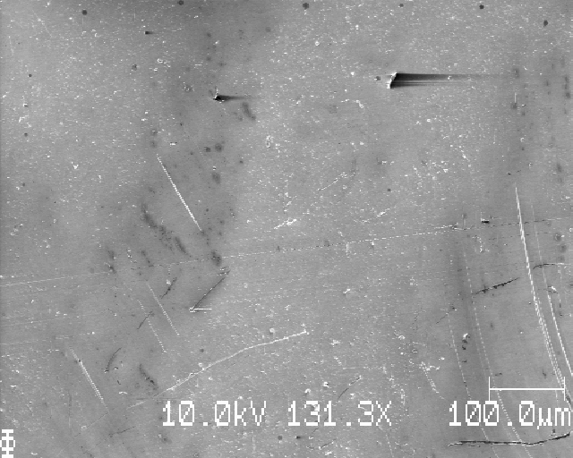
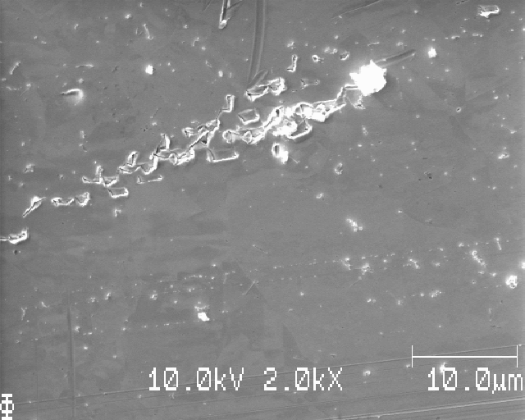
S21:

Slide 38
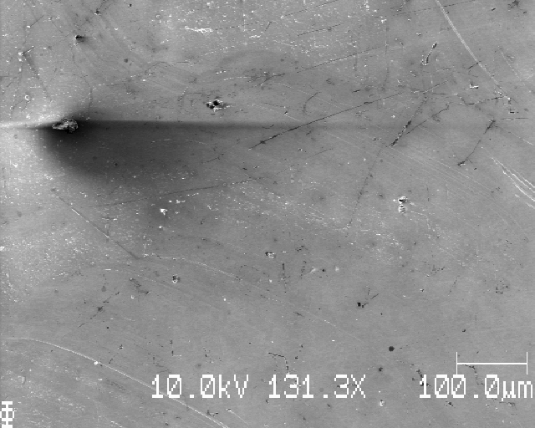
S21:

Slide 39
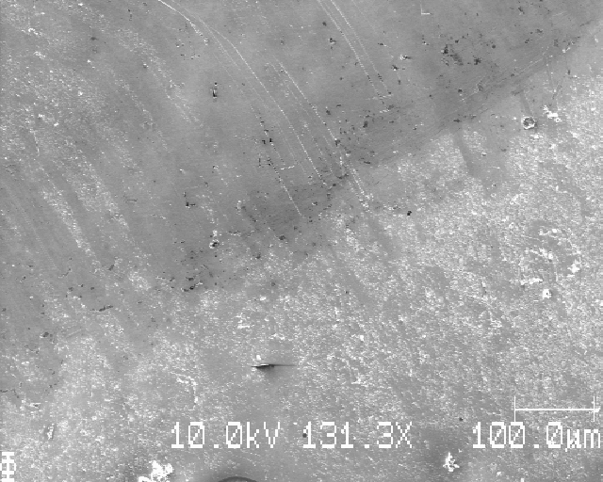
S21: north-west edge of deposition?

Slide 40
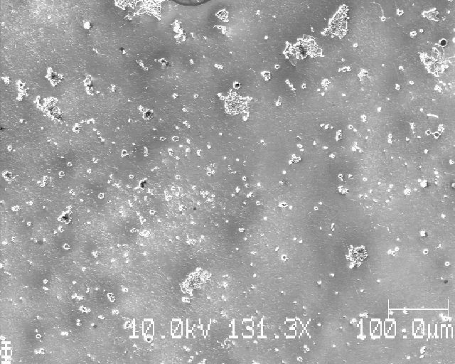
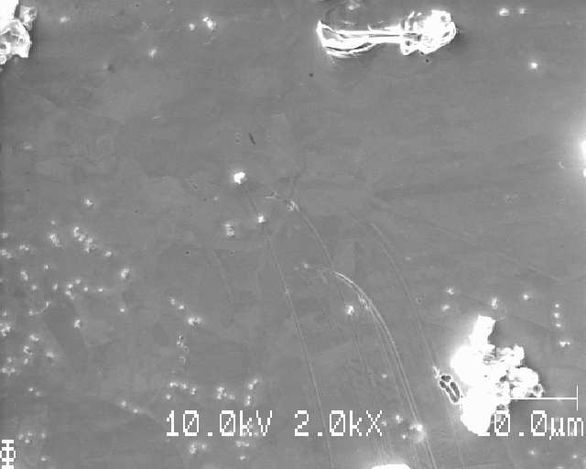
S21:

Slide 41
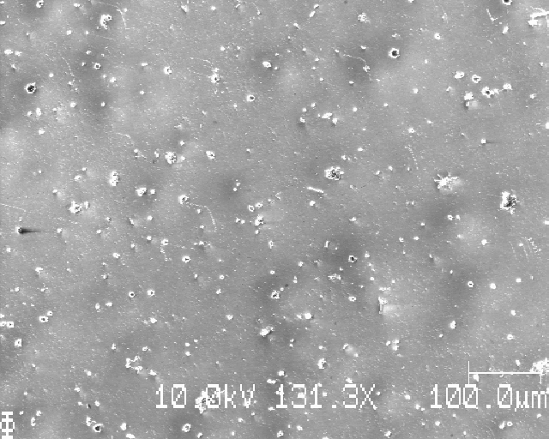
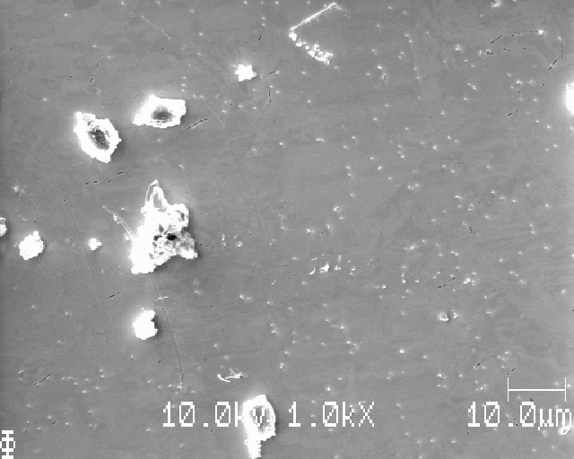
S21:

Slide 42
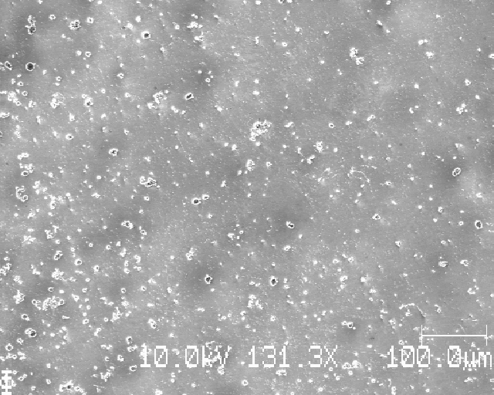
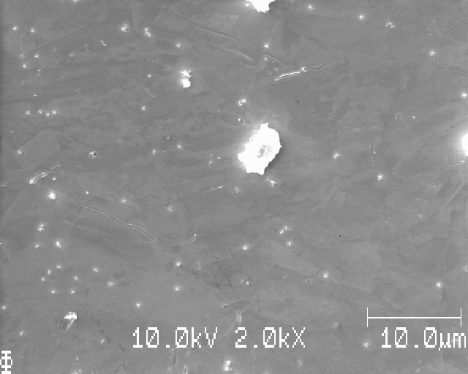
S21:

Slide 43
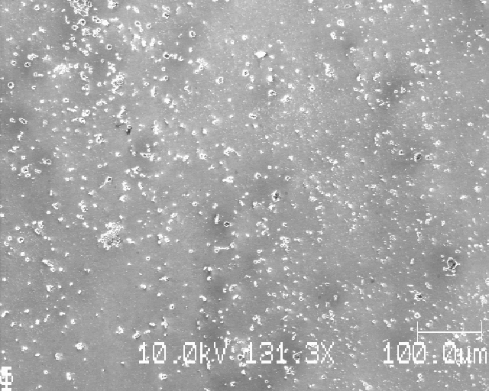
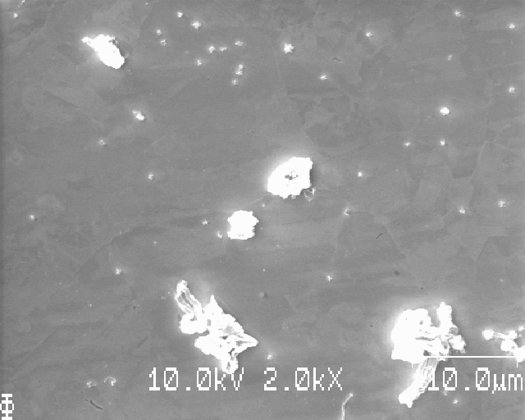
S21:

Slide 44
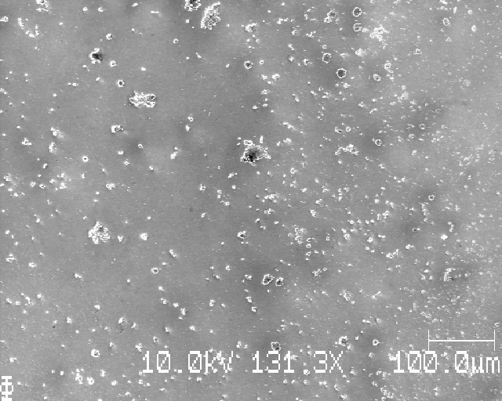
S21:

Slide 45
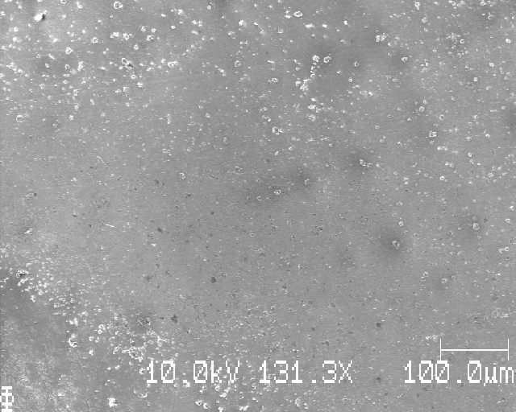
S21:

Slide 46



S21:

Slide 47


S21:

Slide 48

S21: (another sample lays on top of this one)

Slide 49

S21: left edge of sample, moving right dx=0.75mm

Slide 50

S21:

Slide 51

S21:

Slide 52

S21:

Slide 53

S21:

Slide 54

S21:

Slide 55


S21:

Slide 56

S21:

Slide 57

S21:

Slide 58

S21:

Slide 59

S21:

Slide 60

S21:

Slide 61


S21:

Slide 62

S21:

Slide 63
S21: learning points
See Li deposited, despite having stripped the same amount as was deposited in each cycle (and ended after the last stripping of Li)
Inhomogenous Li
Some very small Li that looks like Li that has been stripped (see article Josef sent by mail), but also larger Li structures

Slide 64
(next sample)

Slide 65
S22_Icell_t0000_C0050_J01; LFP/Cu, deposition directly without passivation

Slide 66
S22: top edge of sample, moving down dy=1.0mm

Slide 67


S22:

Slide 68


S22:

Slide 69


S22: larger scratch-marks here is likely due to me accidentally scratching the surface with the pincer during washing or handling of the Cu after cycling

Slide 70


S22:

Slide 71


S22:

Slide 72


S22:

Slide 73



S22:

Slide 74



S22:

Slide 75


S22:

Slide 76


S22:

Slide 77

S22:

Slide 78

S22: left edge, moving right dx=1.0mm

Slide 79

S22:

Slide 80

S22:

Slide 81

S22:

Slide 82

S22:

Slide 83

S22:

Slide 84

S22:

Slide 85

S22:

Slide 86

S22:

Slide 87

S22:

Slide 88
S22: (kom utanfor kanten vid denna bild)

Slide 89
S22: learning points
Small black ‘holes’(?) observed in the Cu
Li deposition clearly uneven despite using LFP as cathode material
Uneven Li ‘globally’ and ‘locally’
Some larger structures observed

Slide 90
(next sample)

Slide 91
S24_Icell_t000_C0050_J01; LFP deposited without passivation

Slide 92

S24: top edge of sample, moving down, dy=1.0mm

Slide 93


S24:

Slide 94


S24:

Slide 95


S24:

Slide 96


S24:

Slide 97


S24:

Slide 98


S24:

Slide 99


S24:

Slide 100


S24:

Slide 101


S24:

Slide 102

S24:

Slide 103

S24: left edge, moving right dx=1.0mm

Slide 104

S24:

Slide 105

S24:

Slide 106

S24:

Slide 107

S24:

Slide 108


S24:

Slide 109


S24:

Slide 110

S24:

Slide 111


S24:

Slide 112


S24:

Slide 113

S24: right edge

Slide 114
S24: learning points
Much more even deposition (the unevenness is more or less the same ‘everywhere’, at least in more places than S23)
Small black spots (‘holes?’) observed for this sample too (LFP used in both)

